Slide 1

VMWARE CAP HACKATHON
Idea Presentation on
STAFF MANAGEMENT TOOLS
Presented by -
Name - Tanya Kumari
College - BIT Mesra

Slide 2
Overview
Staff management tool is the management subordinates in the organisation VMWare , that supervises and administer the activities and ensure the well being of the staff . At the same time the company also satisfies all the business needs.
Problem Statement
The problem statement of the model is to predict the right resources required at each hour to take calls and chats , for resource management in remote IT Service Desk
Staff management is required to supervise and administer the the activities of an organisation and to ensure the well -being of the staff

Slide 3
OBJECTIVE
The main objective of this model is to provide sufficient staffing round the clock , so that there is an immediate support with very less waiting time on calls and chats .
And also to ensure that their is less abandoned calls/chats due to sufficient resources .

Slide 4

The steps performed
Step 1 : Analyse the data provided
Data given -
Historical volumes for both calls and chats for two month are provided (feb and mar)
Average Handling Time of calls and chats at service desk is given .
Chats - 14 mins, Calls - 23 mins
Shift hours of employes .
On daily basis 7h 30 mins (excluding 1.5 hours)
On weekly basis 5 days ( 2 days off )

Slide 5
Step 2 :
The next step would be find the increase in number of calls and chats for the next month.
So this can be done by finding the percentage increase of the average for two months and calculating for the next fiscal month (april)
We, observe that
Average calls for feb month - 116 calls/per day
Average call for mar month -120 calls/per day
% increase - 3.4%
Average calls for april - 124 call/per day
Total no. of calls for april - 3720
Average chats for feb month - 310 chats/per day
Average chats for feb month - 337 chats/per day
% increase - 8.7%
Average chats for april - 353 chats/per day
Total number of chats for april - 10590
Step 3:
Now we will observe the daily trend in number of calls and chats for both the months (feb & mar).
From this we will find the ratio of number of cases for each day to the total cases in the month
And then we will take the average of the ratios for both the month and multiply it with the total number of calls/chats for the next month (april).
This will provide us with the number of calls/chats for each day

Slide 6
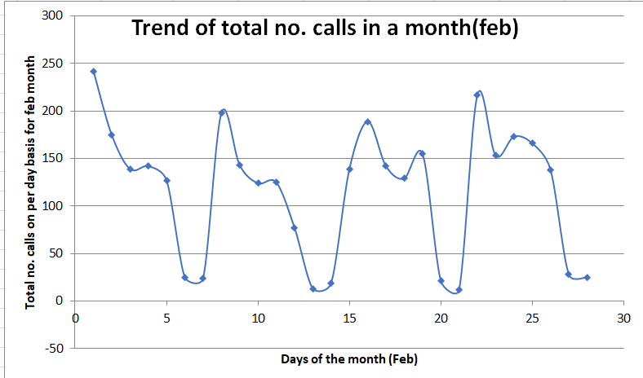
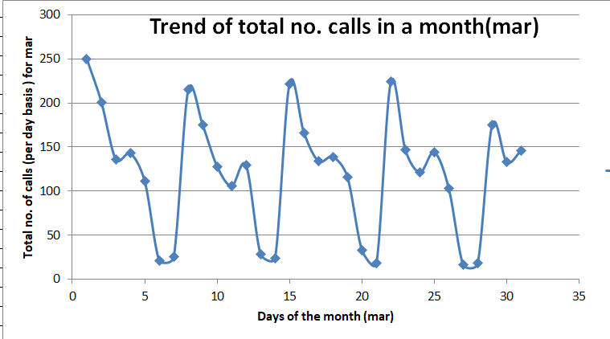
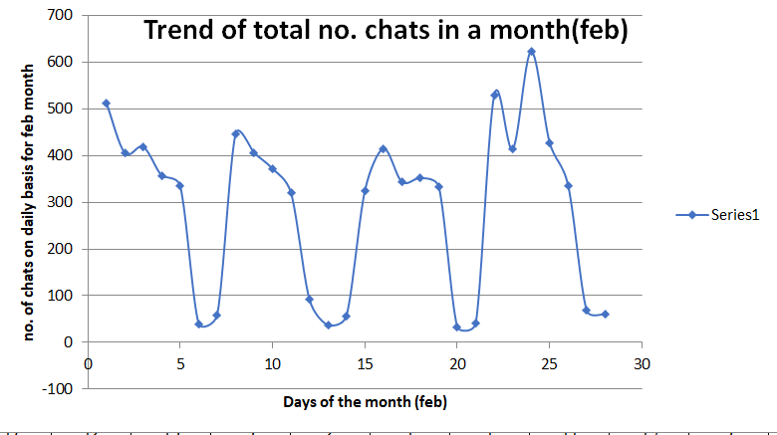
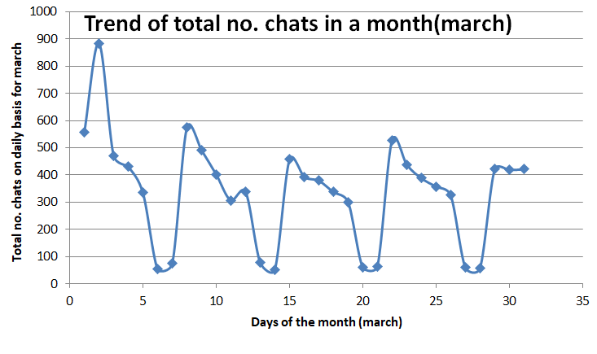

Slide 7
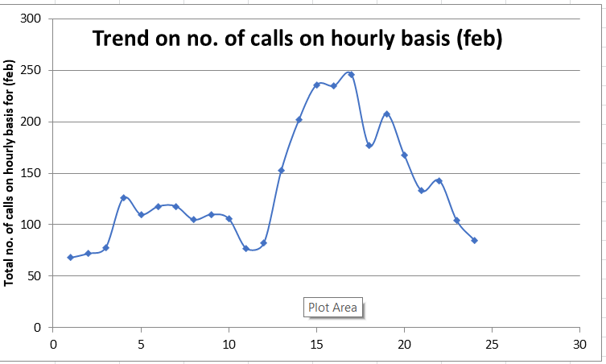
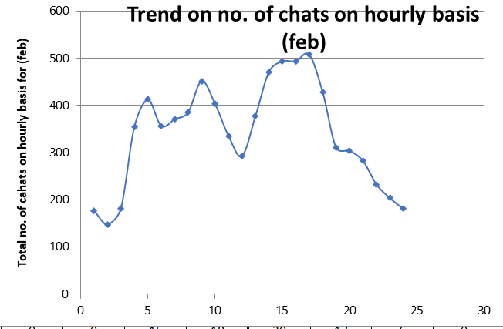
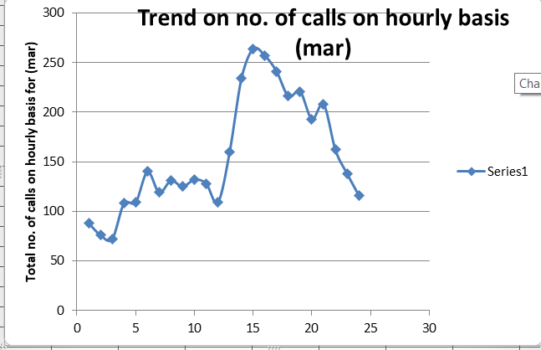
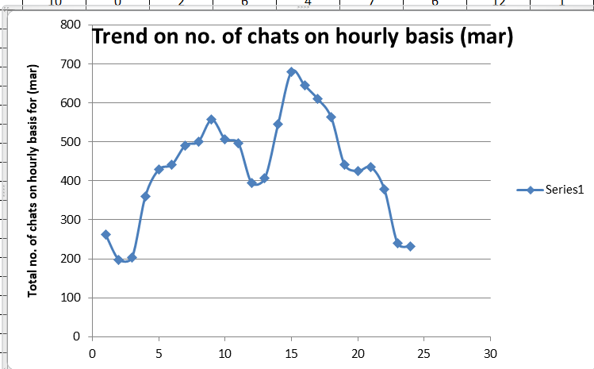
Step 4 :
The next step would be to find the number of cases in different time zones for each day.
So here also we will take the ratio no. of calls/chats in a particular time to the total no. of calls/chats on that day.
We will then take the average of ratio for both the months (feb and mar) and multiply it with daily number of cases for each day (which we obtained in STEP 3)

Slide 8
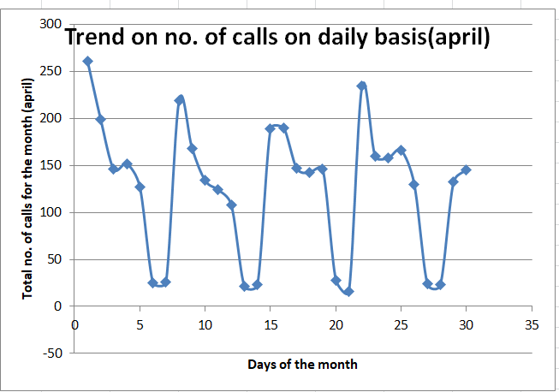
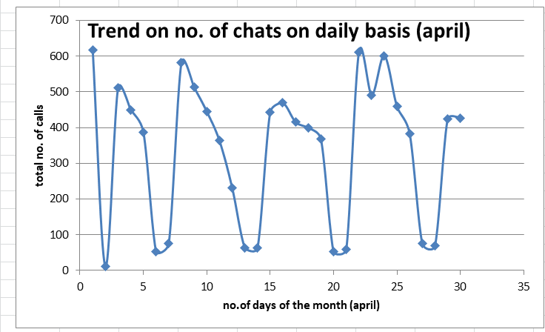
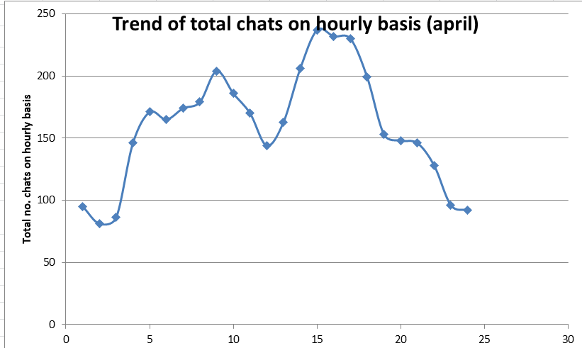
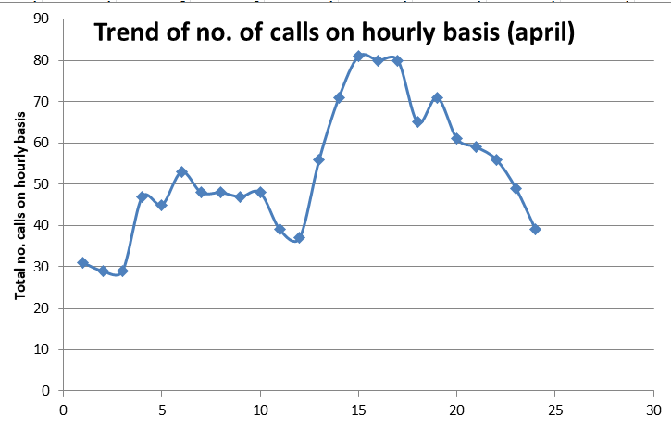
These are variation of total no. calls and chats on daily basis as well as on hourly basis . We can use this for verification

Slide 9
Step 5:
Now we know the number of calls/chats of each day and at different time zones , so the next next would be to calculate the number of employees needed on hourly and daily basis.
It is given,
Average handling time for calls - 14 mins
Average handling time for chats - 23 mins
For simplicity , I rounded off the average handling time of calls and chats to 15 mins, 20 mins respectively.
So accordingly in one hour an employee can attend 4 calls minimum.
And for chats an employee can reply to 3 chats minimum .
ASSUMPTION AND WHY ?
I assume that there are separate employees for both attending calls and replying to chats , because different skills of employees are employed for different works . And also they are trained differently
The next I assumed that if there are more no. calls and employees assigned for chatting are free, then they attend calls also and so for the vice-versa process.

Slide 10
The solution
Step 6:
We will then find out the average no. of employees needed at different time zones
For example avg of employees needed at 6:30 AM = total no. of employees at 6:30 AM over the month / no. days in the month
This same process we will used to calculate for the avg no. of employees for all the time zones.

Slide 11
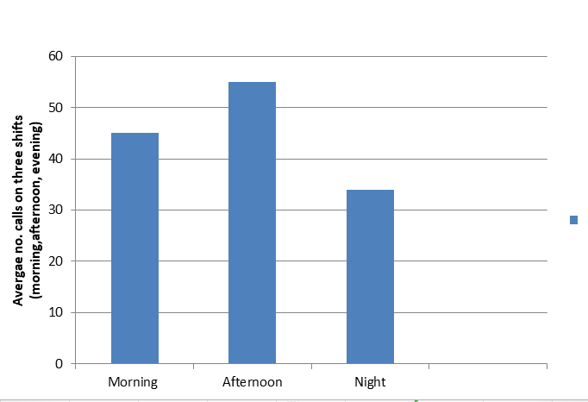
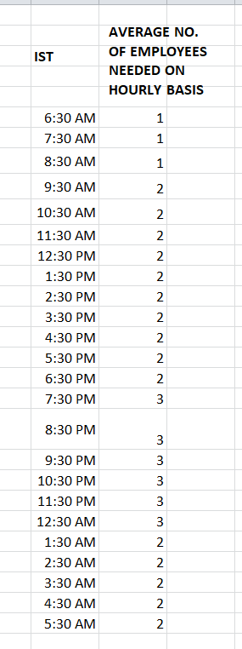
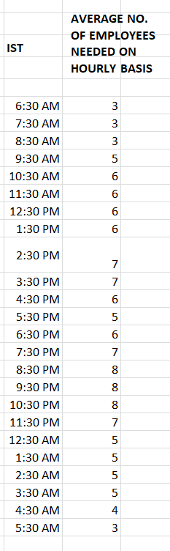
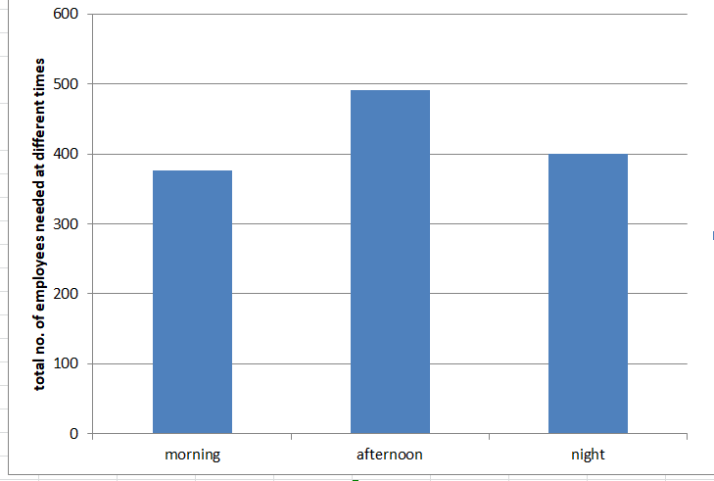
CALLS
CHATS
We observe the the no. of employees needed to both calls and chats is maximum in afternoon followed by night and least employees are needed in the morning.

Slide 12
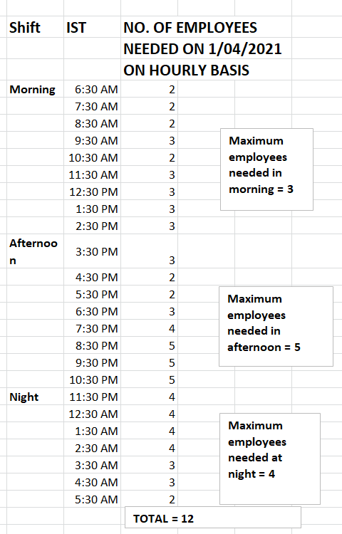
Step 7 :
Now we have to calculate no. of employees needed on daily basis.
So for this we will divide the day into three shifts
Considering the average working hour of each employee to be 8 hours .
Morning shift - (6:30 A.M - 2:30 P.M) - 9 hours
Afternoon shift -(2:30 P.M - 10:30 P.M) - 8 hours
Night shift - (11:30 P.M - 5:30A.M)- 7 hours
For the calculating the no. of employees needed each day we will take the out the maximum number of employees needed at each shifts.
And then add them to get the total number of employees for each day.
The same process we will follow for all days of the month.
Sample calculation for no. of employees for each day.

Slide 13
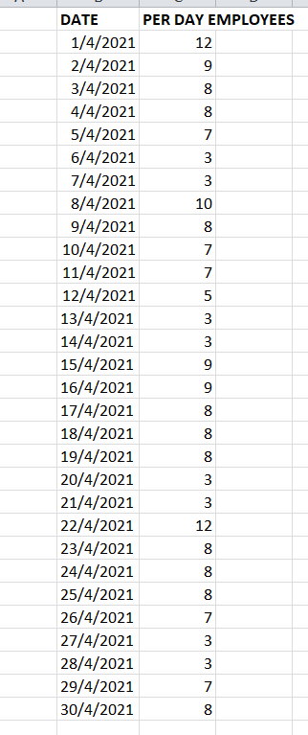
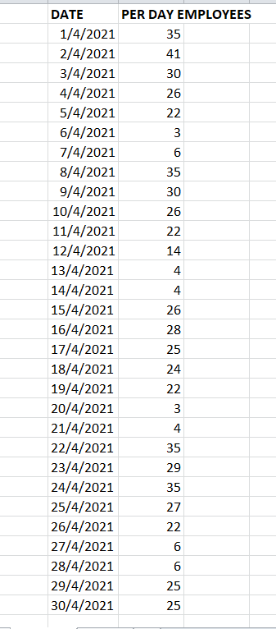
Per day requirement of employees for attending the calls
This is the sample data for the next month , here we consider for the immediate next month (april) with 30 days.
Per day requirement of employees for replying to the chats

Slide 14
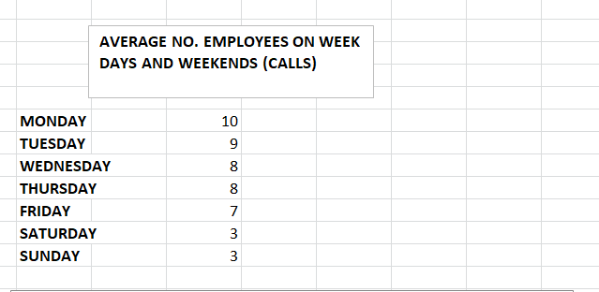
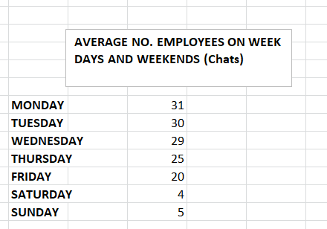
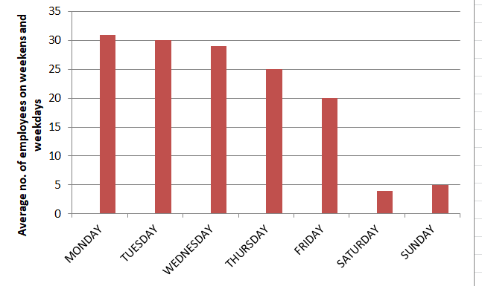
We found that on weekdays there is a more requirement of employees than on weekends , for the attending calls.
We found that on weekdays there is a more requirement of employees than on weekends , for replying to chats.

Slide 15
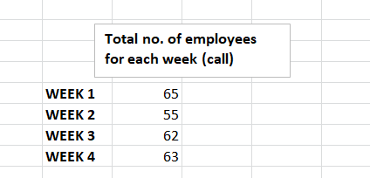
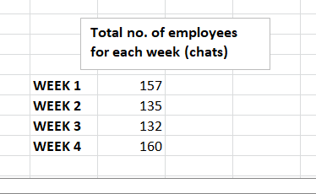
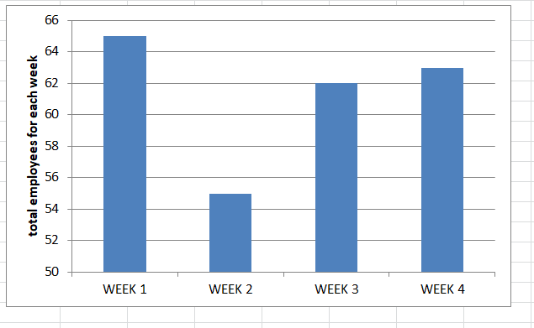
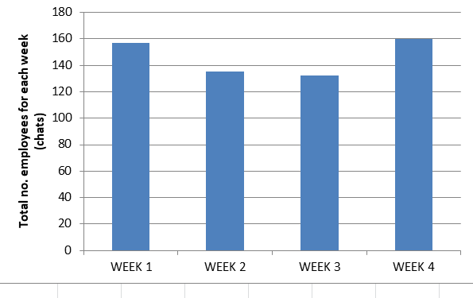
Step 8:
Now we have to calculate the number of employees needed for each week .
It was given that the each employee works for 5 days and takes 2 days off
So , for calculating the total no. employees per week
= s + (7-5/7) *s
(s= total no. of employees for a week obtained from Step Step 7)
No. employees needed to reply to chats on weekly basis
We observed that Week 1 of every month requires the maximum number of employees followed by Week 4
No. employees needed to attend calls on weekly basis.
We observed that Week 1 of every month requires the maximum number of employees, followed by Week 4

Slide 16

THANK YOU !!!!!!

